Slide 1


ArcticStar Dashboard
Optimizing Retail & Logistics through Interactive Business Intelligence
End-of-Cohort Project Presentation

Slide 2


The Problem
Retail businesses currently struggle to monitor operational performance due to fragmented and unstructured data.
Inability to accurately track manager performance and speed.
Lack of visibility into fluctuating shipping costs.
Difficulty analyzing daily revenue trends across regions.
Logistical bottlenecks remain hidden in static spreadsheets.

Slide 3






Our Solution
Centralized Data
Custom DAX
Interactive UI
We built a robust, 1-to-many relational Star Schema connecting fragmented sales, shipping, product, and employee records.
Engineered dynamic backend calculations to measure exact processing times, distinct order counts, and net shipping costs.
A multi-page Power BI dashboard featuring dynamic slicers, allowing stakeholders to filter and analyze data instantly.

Slide 4


Tracking What Matters
Actionable Metrics at a Glance
Instead of digging through tables, executives are presented with immediate health indicators of the business:
Total Revenue: Adjusted for discounts and unit price.
Total Orders: Distinct counts preventing duplicate line items.
Core KPIs Engineered
Shipping Costs: Aggregate freight expenses.
Avg Processing Time: Days between order and shipment.

Slide 5


Dashboard Architecture
Executive Overview (Page 1)
Manager Efficiency (Page 2)
Designed for high-level decision makers. Features top-line KPI cards, dynamic line charts for revenue trends over time, and conditionally formatted matrices that highlight the most profitable product categories in green and underperforming ones in red.
Designed for operational oversight. Focuses heavily on employee productivity, utilizing clustered bar charts to visually rank sales managers based on their average processing speed and the volume of orders they successfully handle.

Slide 6
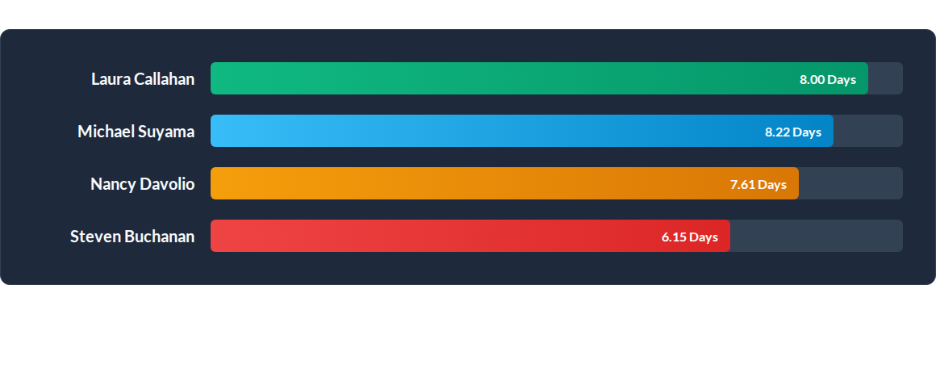
Identifying Bottlenecks
Example Output: By tracking Average Processing Time per employee, the dashboard instantly highlights those handling high order volumes (Laura Callahan) against those processing shipments faster (Steven Buchanan).

Slide 7

Industry Impact
Optimizing Retail Operations
This project directly answers the retail sector's demand for agile, data-driven supply chain management.
By transforming static historical data into a live, interactive environment, stakeholders can immediately identify shipping delays, reallocate resources to high-volume managers, and ultimately reduce operational costs.

Slide 8




Project Next Steps
Q2 - Refinement
Q4 - Deployment
Enhance DAX logic and apply advanced UI/UX dashboard styling.
Conduct usability testing with targeted stakeholders for final launch.
Q1 - Review
Q3 - Integration
Submit `.pbix` file for technical mentor review and feedback.
Connect backend schema to live database sources for real-time updates.

Slide 9
Questions?
Thank you for your time and attention.

